Slide 1

ASP.NET Core Identity
Implementing login/logout, Scaffolding
SoftUni Team
Technical Trainers
Software University
https://softuni.bg

Slide 2
Table of Contents
Authentication vs. Authorization
ASP.NET Core Identity
Scaffolding Identity

Slide 3
Have a Question?
sli.do #csharp-web

Slide 4

Authentication vs. Authorization

Slide 5
Authentication vs. Authorization (1)
Authentication
The process of verifying the identity of a user or computer
Prerequisite for authorization
Questions: Who are you? How you prove it?
Credentials can be password, smart card, external token, etc.
Authorization
The process of determining what a user is permitted to do on a computer or network
Questions: What are you allowed to do? Can you see this page?

Slide 6
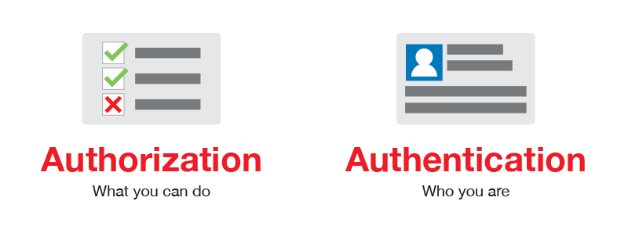
Authentication vs. Authorization (2)

Slide 7

ASP.NET Core Identity

Slide 8
ASP.NET Core Identity (1)
The ASP.NET Core Identity system
Authentication and authorization system for ASP.NET Core
Supports ASP.NET Core MVC, Pages, Web API (JWT), SignalR
Handles Users, User Profiles, Login / Logout, Roles, etc.
Handles cookie consent and GDPR
Supports external login providers
Facebook, Google, Twitter, etc.
Supports database, Azure, Active Directory, Windows Users, etc.

Slide 9
ASP.NET Core Identity (2)
Typically, the ASP.NET Core identity data is stored in relational database
Data is persisted using Entity Framework Core
You have some control over the internal database schema

Slide 10
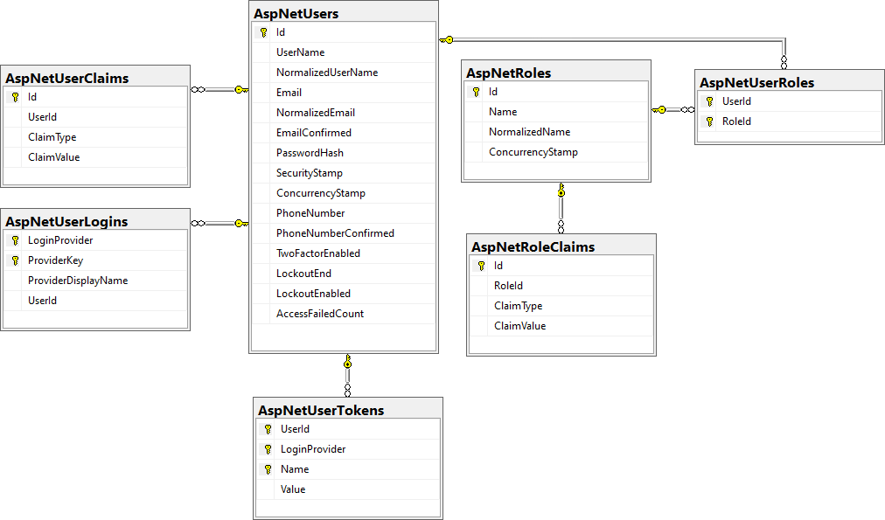
Internal Database Schema

Slide 11

ASP.NET Core Identity System Setup
Setup ASP.NET Identity
Using the ASP.NET project templates from Visual Studio
And then customize it
By hand
Install NuGet packages, manual configuration, create EF mappings (models), view models, controllers, views, etc.
Required NuGet package
Microsoft.AspNetCore.Identity.EntityFrameworkCore

Slide 12


ASP.NET Core Project Template Authentication (1)
ApplicationDbContext.cs
Holds the EF data context
Provides access to the application's data using model objects
Program.cs
Can configure cookie-based (or JWT) authentication
May enable external login (e.g. Facebook login)
Can change default identity settings
Can enable RoleManager with .AddRoles<IdentityRole>()

Slide 13


ASP.NET Core Project Template Authentication (2)
Password settings – can be defined in Program.cs
builder.Services.AddDefaultIdentity<IdentityUser>(options =>
{
// Password, lockout, emails, etc.
options.SignIn.RequireConfirmedAccount = false;
options.Password.RequireDigit = false;
})
.AddRoles<IdentityRole>()
.AddEntityFrameworkStores< ApplicationDbContext >();

Slide 14
User Registration
public async Task<IActionResult> Register()
{
var newUser = new IdentityUser()
{
UserName = "John",
Email = "john@gmail.com",
PhoneNumber = "+359 2 981 981"
};
var result = await userManager.CreateAsync(newUser, "S0m3@Pa$$");
if (result.Succeeded)
// User registered
else
// result.Errors holds the error messages
}

Slide 15
User Login / Logout
Login
Logout
public async Task<IActionResult> Login()
{
bool rememberMe = true;
bool shouldLockout = false;
var signInStatus = await signInManager.PasswordSignInAsync(
"John", "S0m3@Pa$$", rememberMe, shouldLockout);
if (signInStatus.Succeeded) // Sucessfull login
else // Login failed
}
public async Task<IActionResult Logout()
{
await signInManager.SignOutAsync();
}

Slide 16
Authorization
Use the [Authorize] and [AllowAnonymous] attributes to configure Authorized / Anonymous access for Controller / Action
[Authorize]
public class AccountController : Controller
{
// GET: /Account/Login (anonymous)
[AllowAnonymous]
public async Task<IActionResult> Login(string returnUrl) { … }
// POST: /Account/LogOff (for logged-in users only)
[HttpPost]
public async Task<IActionResult> Logout() { … }
}

Slide 17
Check the Currently Logged-In User
// GET: /Account/Roles (for logged-in users only)
[Authorize]
public ActionResult Roles()
{
var currentUser = await userManager.GetUserAsync(this.User);
var roles = await userManager.GetRolesAsync(currentUser);
...
}
// GET: /Account/Data (for logged-in users only)
[Authorize]
public ActionResult Data()
{
var currentUser = await userManager.GetUserAsync(this.User);
var currentUserUsername = await userManager.GetUserNameAsync(currentUser);
var currentUserId = await userManager.GetUserIdAsync(currentUser); ...
}

Slide 18
Add User to a Role
Adding a User to an existing Role:
public async Task<IActionResult> AddUserToRole()
{
var roleName = "Administrator";
var roleExists = await roleManager.RoleExistsAsync(roleName);
if (roleExists)
{
var user = await userManager.GetUserAsync(User);
var result = await userManager.AddToRoleAsync(user, roleName);
if (result.Succeeded)
// The user is now Administrator
}
}

Slide 19
Require Logged-In User in Certain Role
Give access only to Users in Role "Administrator":
Give access if User's Role is "User", "Student" or "Trainer":
[Authorize(Roles="Administrator")]
public class AdminController : Controller
{ … }
[Authorize(Roles="User, Student, Trainer")]
public ActionResult Roles()
{
…
}

Slide 20
Check the Currently Logged-In User's Role
// GET: /Home/Admin (for logged-in admins only)
[Authorize]
public ActionResult Admin()
{
if (this.User.IsInRole("Administrator"))
{
ViewBag.Message = "Welcome to the admin area!";
return View();
}
return this.View("Unauthorized");
}

Slide 21
ASP.NET Core User Manager
UserManager<TUser> - APIs for managing users in a persistence store
Category
AddClaimsAsync(…) | FindByEmailAsync(…) | GenerateChangePhoneNumberTokenAsync(…)
AddToRoleAsync(…) | FindByIdAsync(…) | GenerateEmailConfirmationTokenAsync(…)
IsInRoleAsync(…) | FindByNameAsync(…) | GeneratePasswordResetTokenAsync(…)
ChangeEmailAsync(…) | GetClaimsAsync(…) | IsPhoneNumberConfirmedAsync(…)
CheckPasswordAsync(…) | GetEmailAsync(…) | RemoveClaimsAsync(…)
ConfirmEmailAsync(…) | GetRolesAsync(…) | RemoveFromRoleAsync(…)
CreateAsync(…) | GetType(…) | RemovePasswordAsync(…)
DeleteAsync(…) | UpdateAsync(…) | ResetPasswordAsync(…)
Dispose(…) | UpdatePassword(…) | IsEmailConfirmed(…)

Slide 22

Identity – Extending & Scaffolding

Slide 23
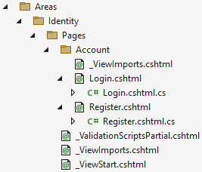
Scaffolding ASP.NET Core Identity
Since ASP.NET Core 2.2, Identity is provided as a Razor Class Library
The scaffolder can be configured to generate source code
If you need to modify the code and change the behavior
Most of the necessary code is generated by the scaffolder
Scaffolded Account.Register and Account.Login

Slide 24
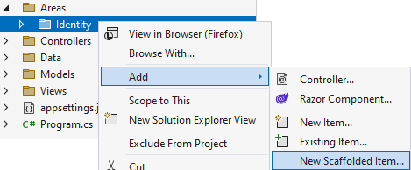
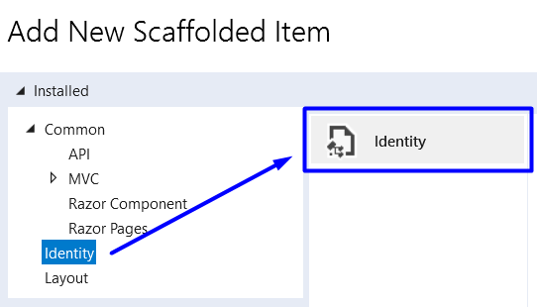
Scaffolding ASP.NET Core Identity in VS
Scaffold Identity pages by adding a new scaffolded identity item:

Slide 25
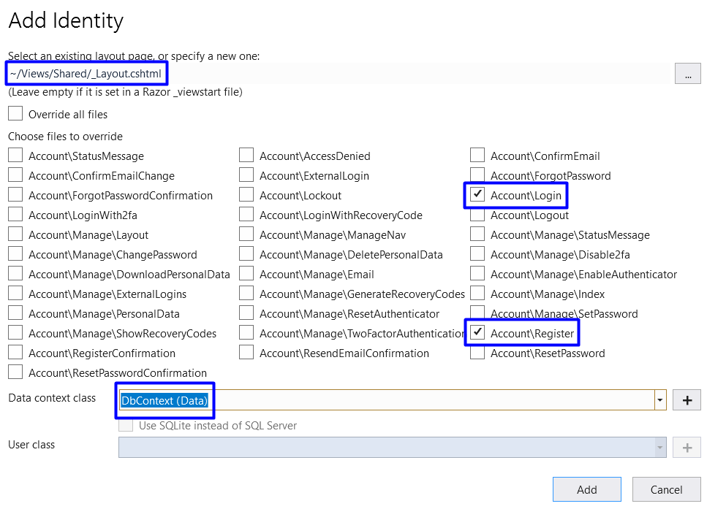
Scaffolding ASP.NET Core Identity in VS (2)
Scaffolded pages will be part of the "/Areas/Identity" folder
Select pages to be scaffolded
Select the layout page
Select pages to be scaffolded
Select the db context

Slide 26
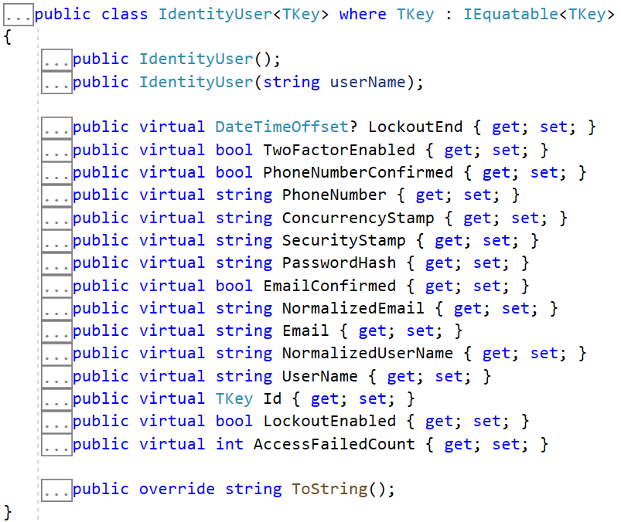
Extending ASP.NET Core Identity
ApplicationUser.cs – can add user functionality
Extends the user information from the ASP.NET Core IdentityUser
May hold additional fields
E.g. first name, last name, birthday
public class ApplicationUser
: IdentityUser
{
public string FirstName { get; set; }
public string LastName { get; set; }
}

Slide 27

Summary
…
…
…
Authentication vs. Authorization
ASP.NET Core Identity
Scaffolding Identity

Slide 28
Questions?
Notes:
28

Slide 29













SoftUni Diamond Partners

Slide 30

Educational Partners

Slide 31
Trainings @ Software University (SoftUni)
Software University – High-Quality Education, Profession and Job for Software Developers
softuni.bg, about.softuni.bg
Software University Foundation
softuni.foundation
Software University @ Facebook
facebook.com/SoftwareUniversity
Software University Forums
forum.softuni.bg
31
Notes:
31

Slide 32

License
This course (slides, examples, demos, exercises, homework, documents, videos and other assets) is copyrighted content
Unauthorized copy, reproduction or use is illegal
© SoftUni – https://about.softuni.bg
© Software University – https://softuni.bg
Notes:
32

